Slide 1
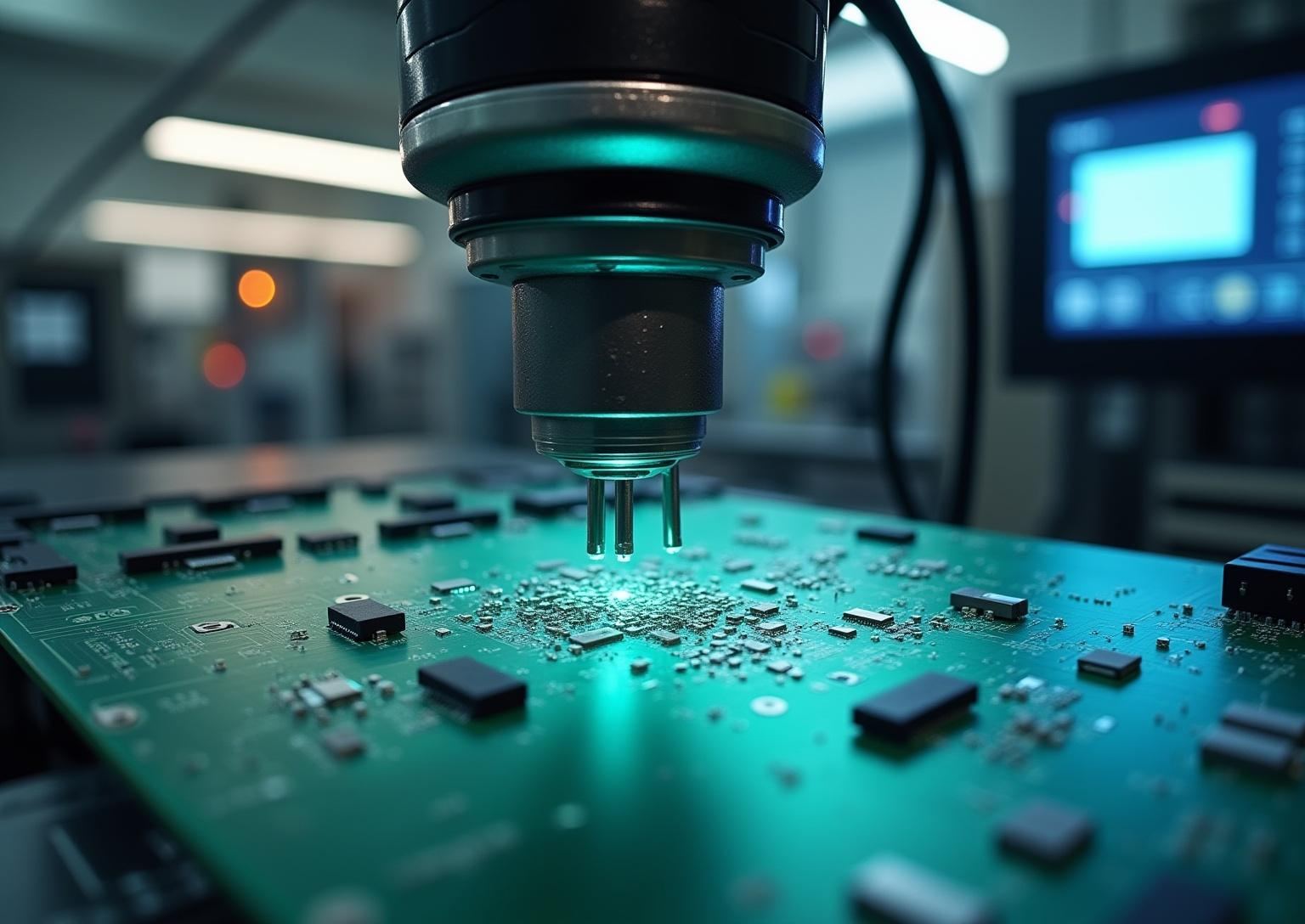
CircuitGuard AI
Automating PCB Defect Inspection

Slide 2

Introduction
Manual inspection of PCBs is slow, error-prone, and inefficient, leading to quality issues. Key defects such as shorts, missing holes, and spurious copper impact production reliability. An AI-powered system is essential to automate and accelerate defect detection, ensuring consistent and accurate quality control in manufacturing processes.

Slide 3

AI-Based PCB Defect
Detection

Slide 4

Challenges in Manual
Inspection
Manual PCB inspection relies heavily on human expertise, which is time-consuming and prone to errors. Variability in inspections can cause missed defects like shorts and missing holes, affecting product quality. This calls for a scalable, reliable system that reduces inspection time and eliminates human errors in defect detection.

Slide 5
Deep Learning Approach
The system employs image subtraction and CNN-based classification using EfficientNet-B4 to accurately detect and localize PCB defects. Processing includes contour extraction and ROI segmentation. The approach achieves over 97% classification accuracy, offering a robust solution for automated PCB quality inspection in real time.

Slide 6
Real-Time Visualization
A Streamlit-based web application facilitates real-time defect visualization and user interaction. Users can upload PCB images, trigger inference, and receive annotated outputs highlighting detected defects. This interactive interface supports fast inspection cycles and seamless integration into manufacturing workflows, enhancing productivity and quality assurance.

Slide 7

System Design and
Performance

Slide 8
Architecture and Workflow
The system uses a dual-image input: a defect-free reference and a test PCB image. OpenCV performs image subtraction, followed by contour extraction and ROI segmentation. Defect classification is achieved through EfficientNet-B4 implemented in PyTorch. The annotated results are presented via the Streamlit UI for easy review and analysis.

Slide 9
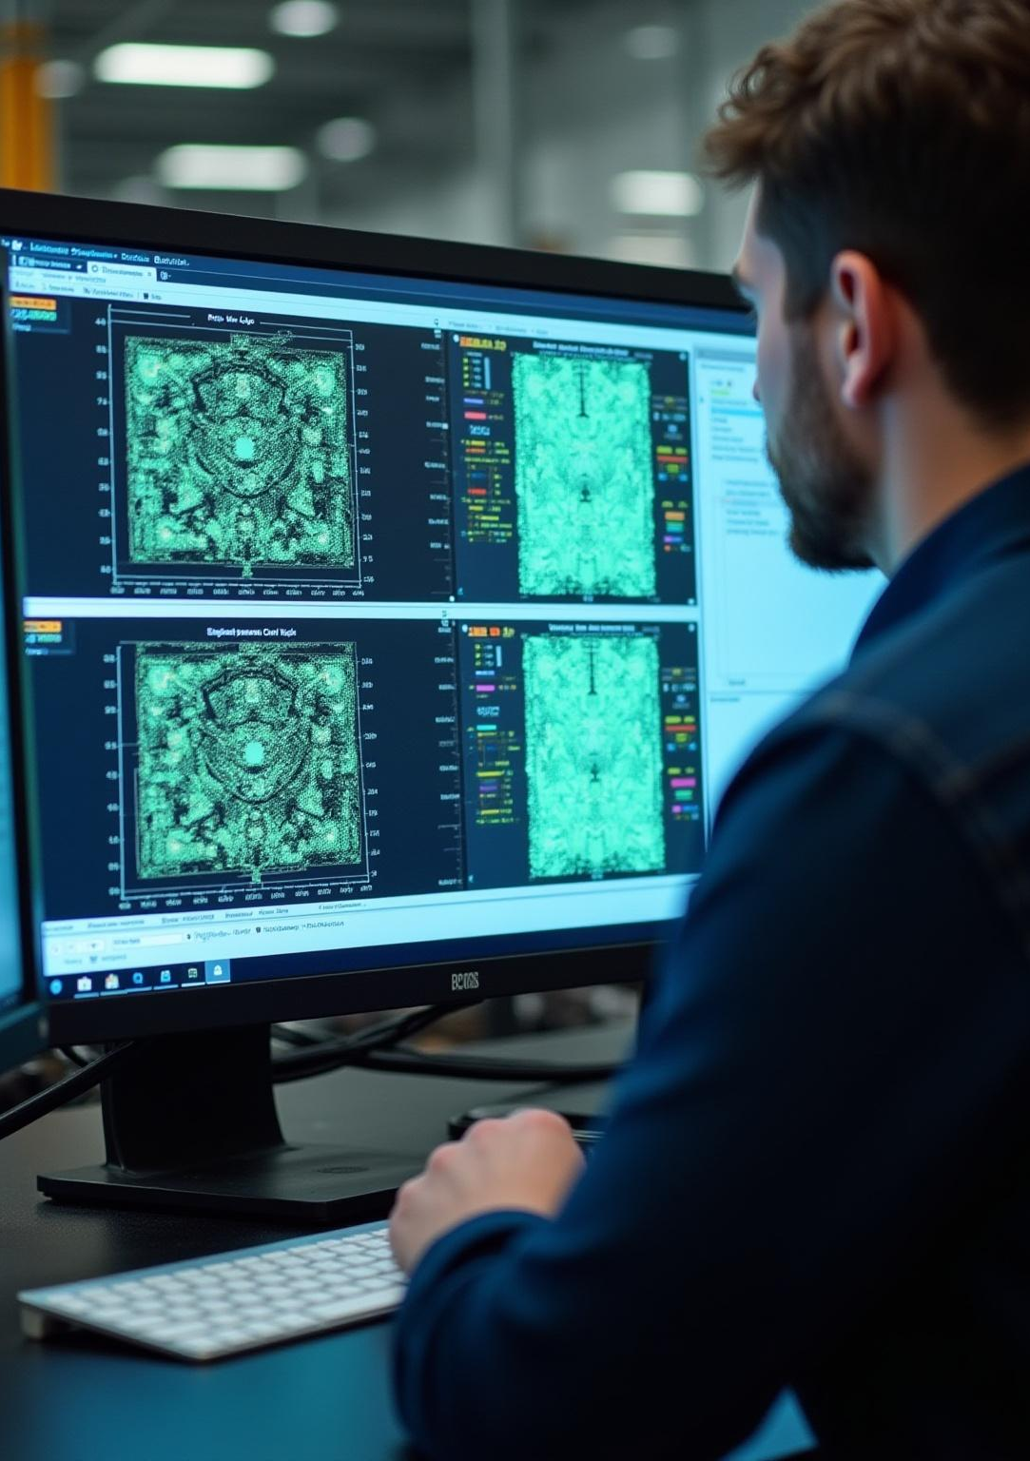
Results and
Metrics
The model achieves classification accuracy exceeding 97%, with an inference time of under 5 seconds per image. Outputs include annotated defect maps and exportable logs for thorough quality documentation. This ensures consistent, automated inspection with minimal latency, significantly improving production throughput and reliability.

Slide 10
Future Enhancements and Deployment
Future plans include deploying the system on edge devices for real-time factory use, expanding support to multiple PCB layouts, and integrating predictive maintenance capabilities. These improvements aim to enhance scalability, adaptability, and proactive manufacturing insights, driving smarter and more efficient PCB quality control.

Slide 11
Conclusions
The AI-based CircuitGuard system successfully automates PCB defect detection with high accuracy and speed. Integration of image processing and deep learning techniques has significantly improved inspection reliability. Continued development will focus on deployment scalability and advanced analytics to meet evolving manufacturing demands, ensuring superior product quality and operational efficiency.

Slide 12
THANKS!
Do you have any questions?
youremail@freepik.com
+00 000 000 000
yourwebsite.com
Please keep this slide for attribution

